Slide 1

Bankruptcy
Prevention

Slide 2
By Group – 5
ANIKET AJAYRAO KATYARMAL
MR. HARI PRASATH P
MR. VENKATESH PABBATI
MANASI MILIND MORE
MOHAMMAD FARAZ AHMED
M A RAHMAN
MISS. CHELLOJU SREEHITHA

Slide 3
Introduction
Bankruptcy predictions are classification problems that entail the prediction of the likelihood of failure of a company, given a number of financial ratio shaping to its status.
Bankruptcy is a legal proceeding initiated when a person or business cannot repay outstanding debts or obligations. It offers a fresh start for people who can no longer afford to pay their bills.

Slide 4
Goals of Bankruptcy
Rehabilitation of troubled businesses (Chapter 11)
A “fresh start”
Fair and orderly distribution of assets among creditors and equity holders
Maximize value of the debtor’s estate

Slide 5
Dataset Details
The data file contains 7 features about 250 companies .
The data set includes the 6 variables and 1 class .
Industrial_risk - 0=low risk, 0.5=medium risk, 1=high risk.
Management_risk - 0=low risk, 0.5=medium risk, 1=high risk.
Financial flexibility - 0=low flexibility, 0.5=medium flexibility, 1=high flexibility.
Credibility - 0=low credibility, 0.5=medium credibility, 1=high credibility.
Competitiveness - 0=low competitiveness, 0.5=medium competitiveness, 1=high competitiveness.
Operating_risk - 0=low risk, 0.5=medium risk, 1=high risk.
Class - bankruptcy, non-bankruptcy (target variable).

Slide 6
The steps we used
Open Xlsx file select all data .
Sort the data and save the file .
Load the dataset file.
Import libraries.
Create code .
Run the Code .

Slide 7
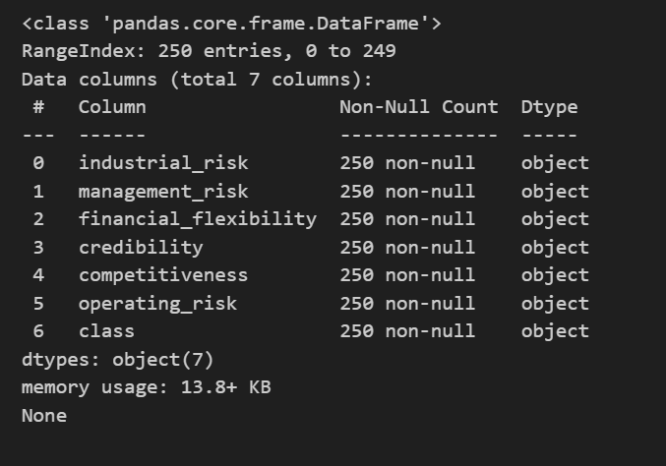
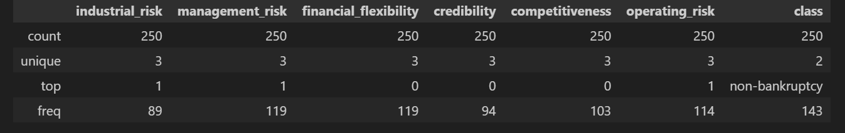
Display information about dataset
Read the Excel file and split into columns

Slide 8
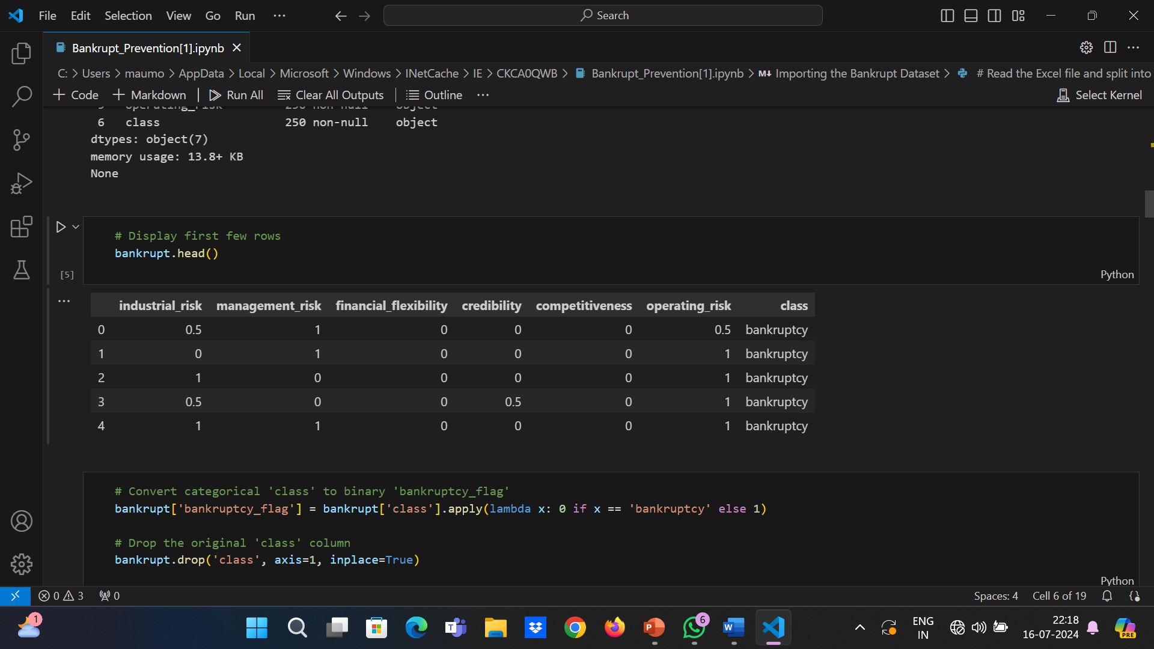
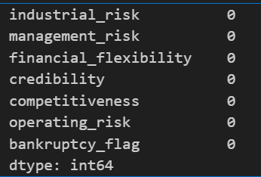
Display first few rows
checking is there any missing values are there in data or not

Slide 9
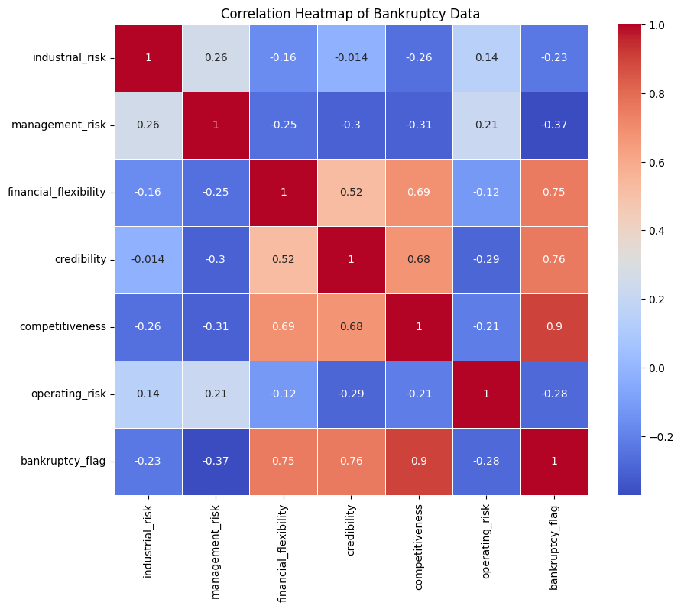
Exploratory Data Analysis (EDA)

Slide 10
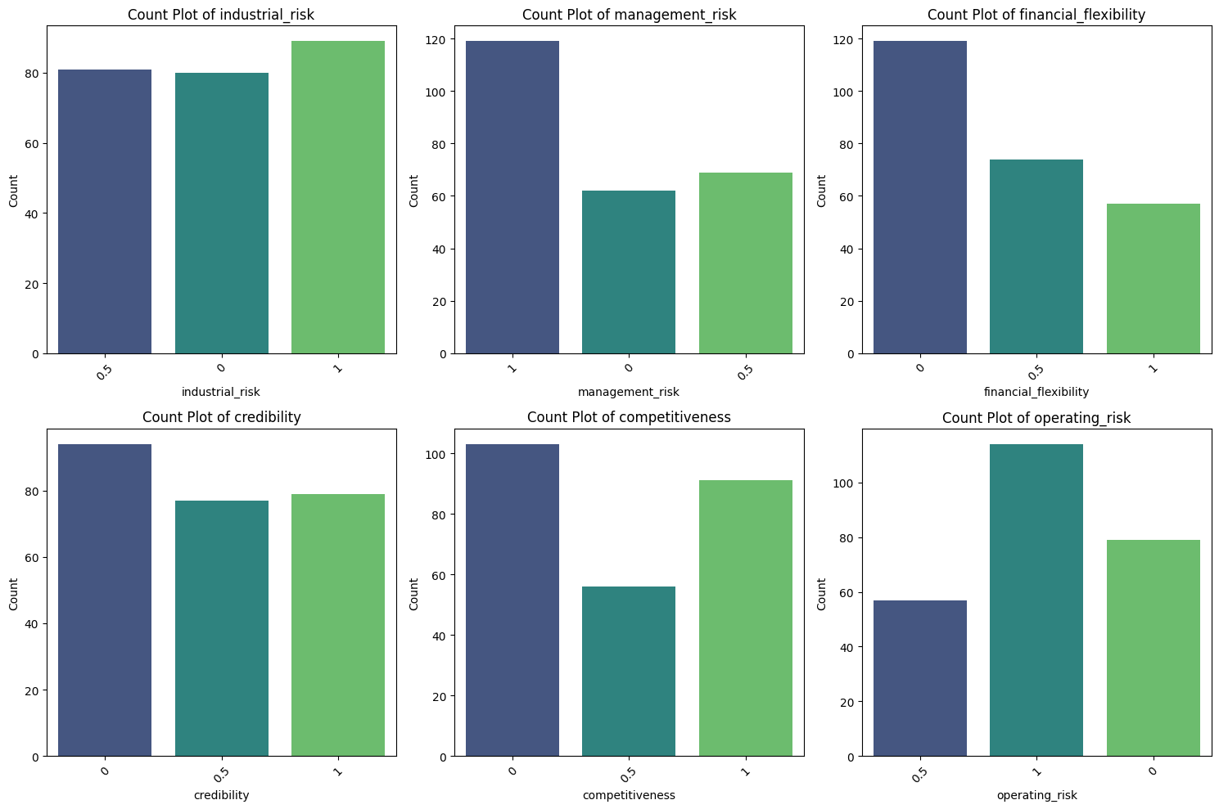
Exclude numeric columns for count plotting

Slide 11
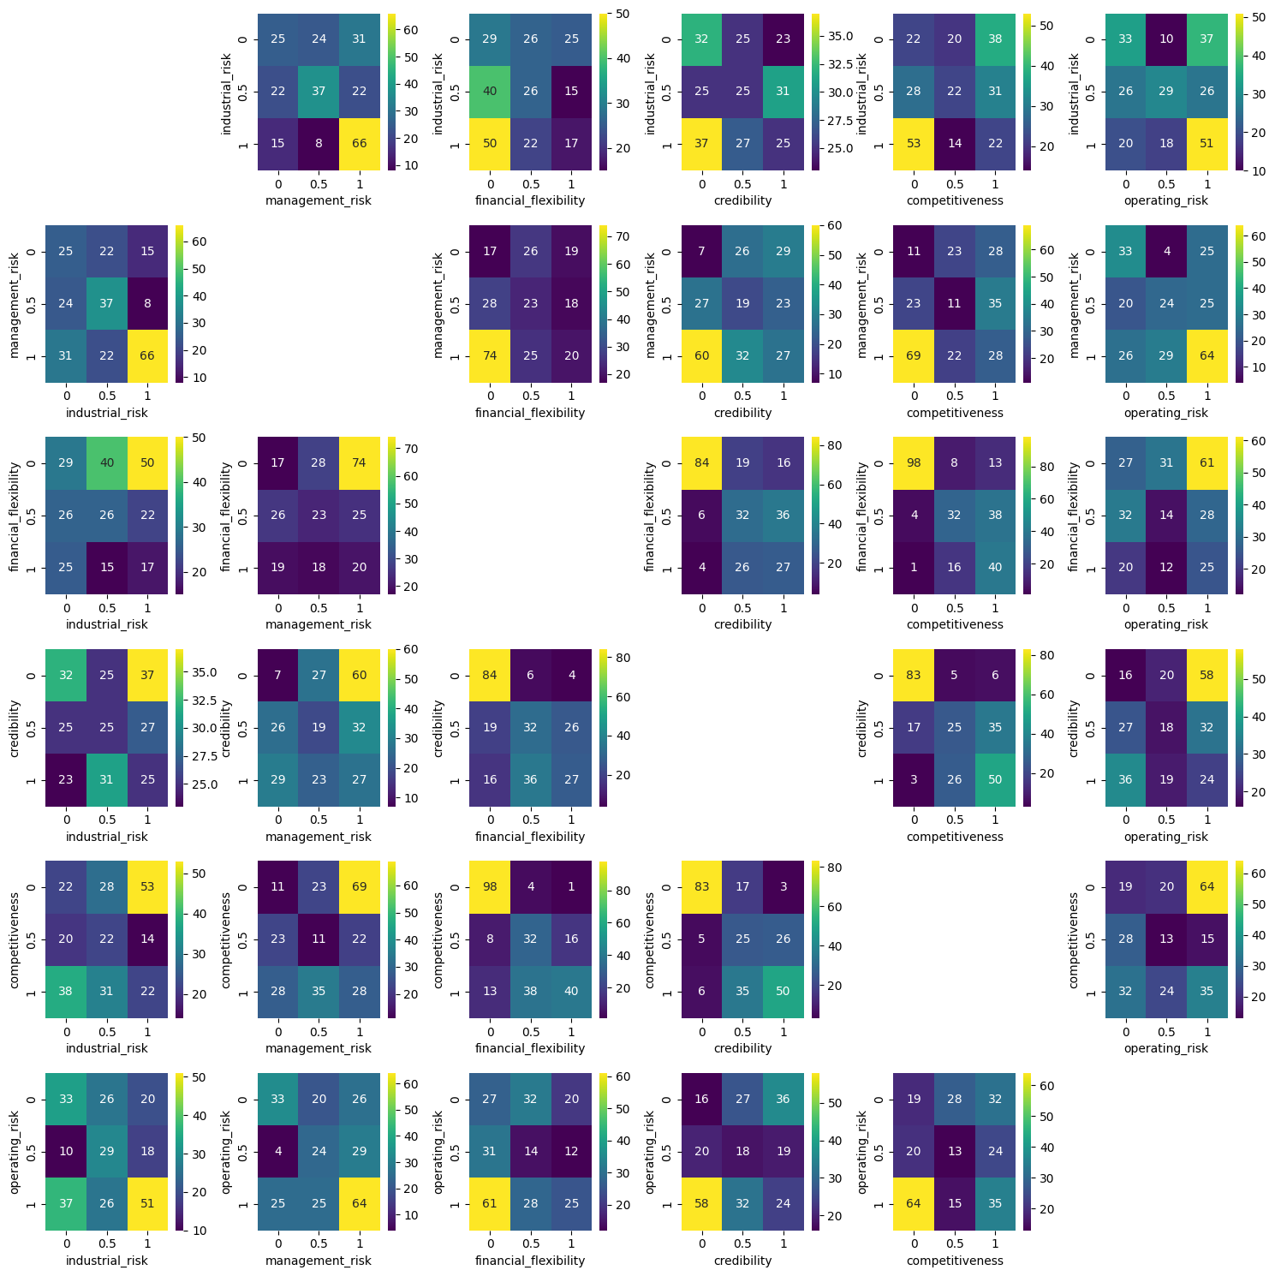
Exclude numeric columns for crosstab

Slide 12
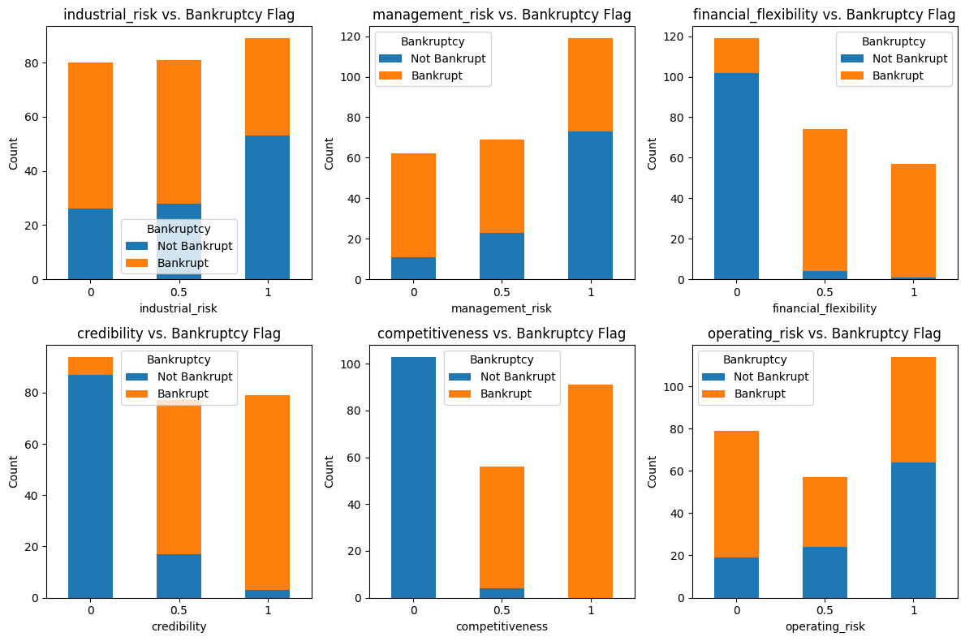
Selecting categorical columns for crosstab analysis

Slide 13
THANK YOU !

